Slide 1

NNNNNNNNBBBBBBBBBBB
Domain: Java,Swing Application
Technology : Core java
BRICK BREAKER GAME

Slide 2

DISCRIPTION ABOUT GAME:
Brick breaker game is designed using java software play by the game lovers this game ‘s objective is to eliminate all of the bricks but ,if the ball does not touch the paddel while playing the game, the player loses and the game ends! To play this game again we need to press the enter to restart the game. To win the game all the bricks must be eliminated .

Slide 3
SOFTWARe requirements
Java Development Kit
Sts Spring Tool or Eclipse
FUNCTIONAL REQUIREMENTS
User will be able to control the paddel using arrow keys to move right,left in the frame.
When we press the enter in keyboard and the game will be restarted again.
INTRODUCTION:

Slide 4
We are having three class
Main Class
Game play Class
Map generator Class
Creating a frame
1. IN MAIN CLASS:
We create Jframe outer window this is a building class .
We set the properties for this Jframe like size,title,resizeable close operation.
IMPLEMENTATION :

Slide 5
2.In game play class
Creating a paddel
Creating a ball
extending Jpannel and we implementing interface KeyListener and ActionListener.
Implementing interface KeyListener,ActionListener.
KeyLisener is used when we press the arrow keys in the game to move and detect the paddel.
ActionListener is used moving and detecting the ball.
We create a paddel in this class it does not go outside of the frame because we have a condition in our code.
.We create a ball and to move that ball left,right and top we write a code . We import timer class to move that ball in selected time.
To make an intersection for paddel and ball we use rectangle to make an intersection around the ball and the paddel.

Slide 6
MAP GENERATORS
Creating a bricks
In this class we use 2Dimensional array to create brick height and brick width.we import graphics to draw the bricks in a particular position.
By using this map bricks are drawn that is 3/7 for breaking bricks we need to intersect the ball into the bricks when the bricks are broken by making the value 0.
Here in this case also we use rectangle to intersect that ball into the bricks .
3.MAP GENERATORS
Creating a bricks

Slide 7
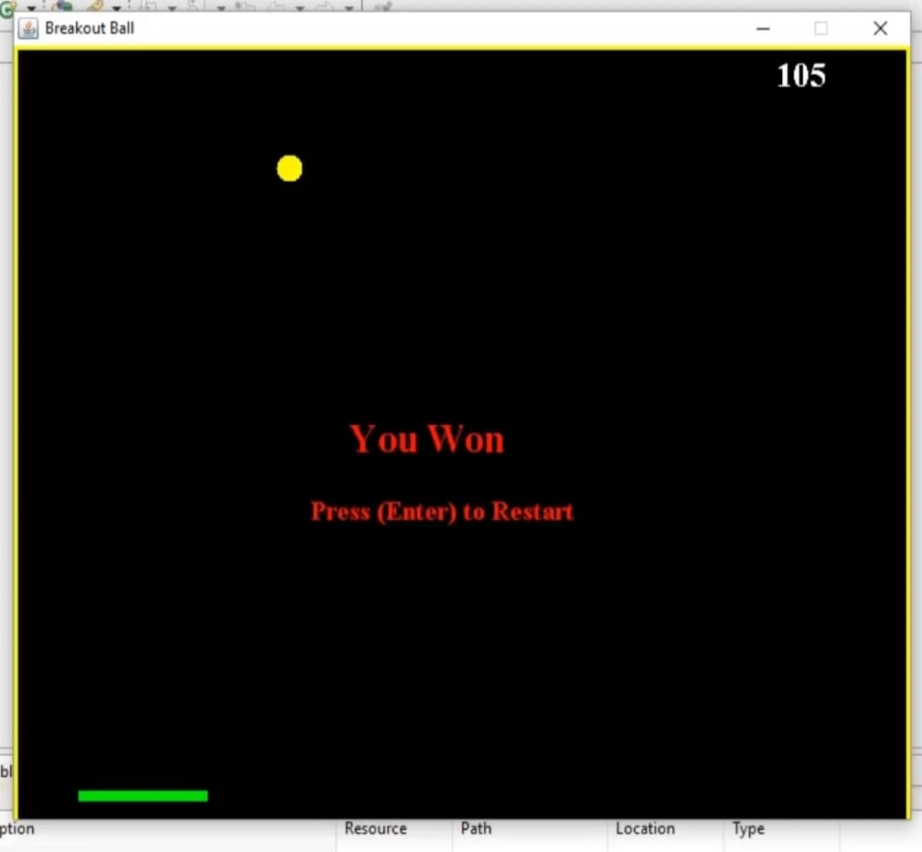
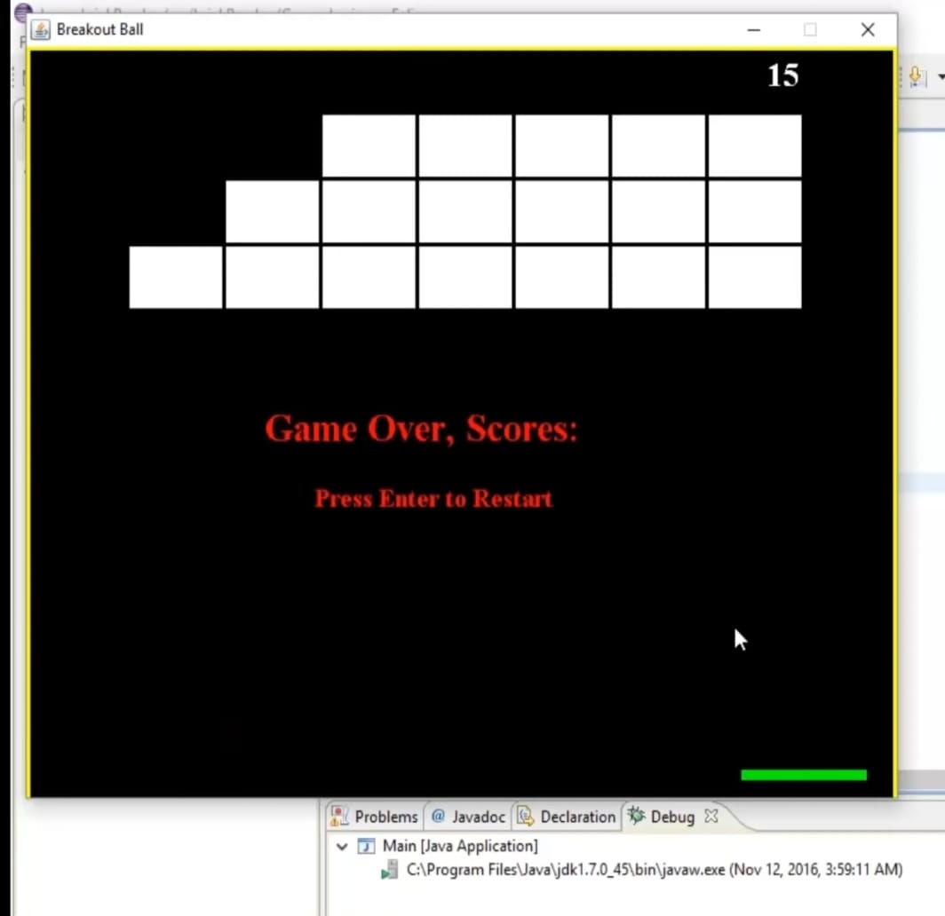
DISPLAYING THINGS ON THE SCREEN :
For setting scores we need to display scores incrementing 5 for this we add code in the game play class .
We should add code for game over and press enter to restart for working restart we added code in key pressed event.
If we completed the game it will display like “you won the game” and if you lose the game it displays enter to” restart the game” .
when we win game when we loose game

Slide 8


